Slide 1
Getting started
Lesson 2: File management, cloud computing and VLEs

Slide 2
Objectives
In this lesson, you will learn:
how to save and organise files effectively
about cloud computing
how to access material and submit work via the school’s VLE.

Slide 3


Slide 4
Files and folders
All data stored on a computer is saved to a file.
A file that contains text is often referred to as a document. This is because it is like a piece of paper that has been written on.
A selection of files can be stored in a folder.
A folder can also contain other folders, which are technically then called sub-folders.

Slide 5
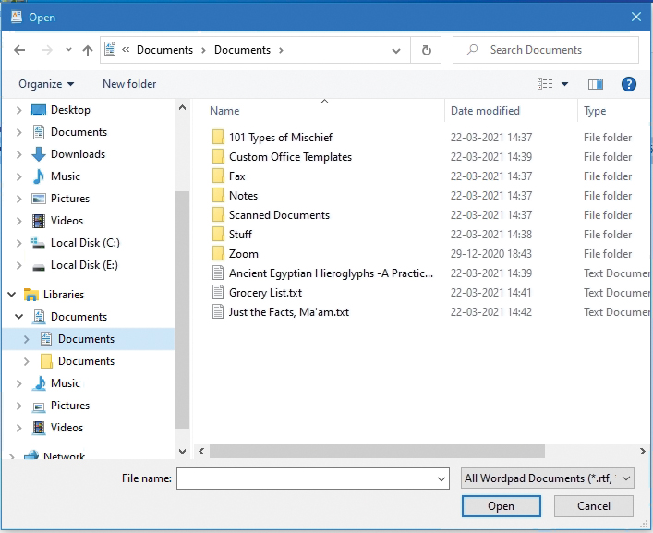
Organising files
To help us find our files quickly, it is good practice to use:
relevant file names
relevant folder names
a sensible folder and sub-folder structure.

Slide 6

Activity 2.1: School file management

Slide 7
File extensions
When we save a file, we give it a name; for example, ‘History_Project’.
The software then adds a file extension that tells the computer what type of file it is. The file extension is usually three or four characters long.

Slide 8
File extensions
Some common file extensions are:
Extension | File type
.doc / .docx / .pdf | Document
.xls | Spreadsheet
.png / .jpg | Image
.mp3 / .wav | Audio
.mp4 / .mov | Video

Slide 9
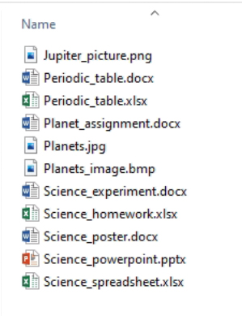
File extensions
The file extension enables the computer to use the correct software when you double click on a file to
open it.
File extensions can also be used to search for files of a particular type if they have not been saved correctly.

Slide 10
Saving work
The first time you save a piece of work, make sure you give it a suitable name and save it to the correct folder.
You can then save changes to the original file quickly and easily using shortcut keys:
CTRL+S in Windows
CMD+S in macOS
If you do not want to overwrite the original file, choose ‘Save As’ from the ‘File’ menu to save a copy of your work. Give the new file a suitable name and save it to the correct folder.

Slide 11


Slide 12
Cloud computing
Cloud computing is where data is stored online and software is used via an internet browser, rather than being stored locally on a computer’s hard drive.
The data and software files are saved on a server.
Server farms are located all around the world so you do not know where your data is physically being saved when you store it in the cloud.
Examples of cloud storage are Google Drive, Microsoft OneDrive® and DropboxTM.
Examples of internet-based software are Microsoft 365® and Google Docs.

Slide 13
Advantages of cloud computing
Data is backed up automatically.
Documents and files can be used on any computer with an internet connection.
The software is updated online so you are always using the latest version.
Documents and files can be shared easily with other users.

Slide 14
Disadvantages of cloud computing
The data and software can only be accessed if you have an internet connection.
Cloud-based software does not usually have as many functions as downloadable software.
Free storage is limited.
Ongoing subscriptions can become costly over time.
Users can lose legal rights to their material if it is stored online.
Data may be more vulnerable to being stolen if it is stored online.

Slide 15
Activity 2.2: File types and extensions
Log into your VLE to access the activity.

Slide 16
Quiz 2

